Slide 1
College Planner React.js Website
Chris Maher – Software Frameworks

Slide 2
Description
The College Planner Website provides the functionality to save a list of college related projects, exams, presentations and other important events related to college. The website is built using the React.js Javascript framework and uses Googles Firebase to save data and Authenticate users.

Slide 3
Features
Ability to register account with profile editing and updating
Save a list of upcoming projects, exams, presentations.
Enhanced notes section with formatting through the React-Quill WYSIWYG editor
Ability to share Group notes with Classmates. Input validation on all forms through Dropdown Selects, Date Pickers and validation rules
Statistics of Users registered and Projects tracked.
Use of JQuery and CSS transitions to enhance website visuals.
Authenticated routes and restricted access for user groups with react-router.

Slide 4
Database & Hosting
This website uses Googles Firebase when developing locally also when deployed to the cloud.
The Database consists of 3 Models. User, Project and College. Each model contains relational keys to other models.
The website is hosted on Heroku. One of the Worlds leading hosts for React.js developers due to its ease of use and reliability.

Slide 5
3rd Party Components
Firebase – Googles Firebase used for both the Storage of Data and the Authentication of Users.
React Fire – The Firebase react library that allows you to use Firebase functions with react.js
React-Router – React router allows the creation of routes in a React SPA. It also allows for the restriction of areas to usergroups.
React-Quill – This WYSIWYG Editor allows for enhanced notes formatting.

Slide 6
Data Models
items
+ uid
+ due
+ notes
+ subject
+ text
+ type
+ user_id FK
+ worth
user
+ uid
+ avatar
+ college
+ email
+ location
+ token
+ username
college
+ country
+ name
+ added_by
+ website

Slide 7
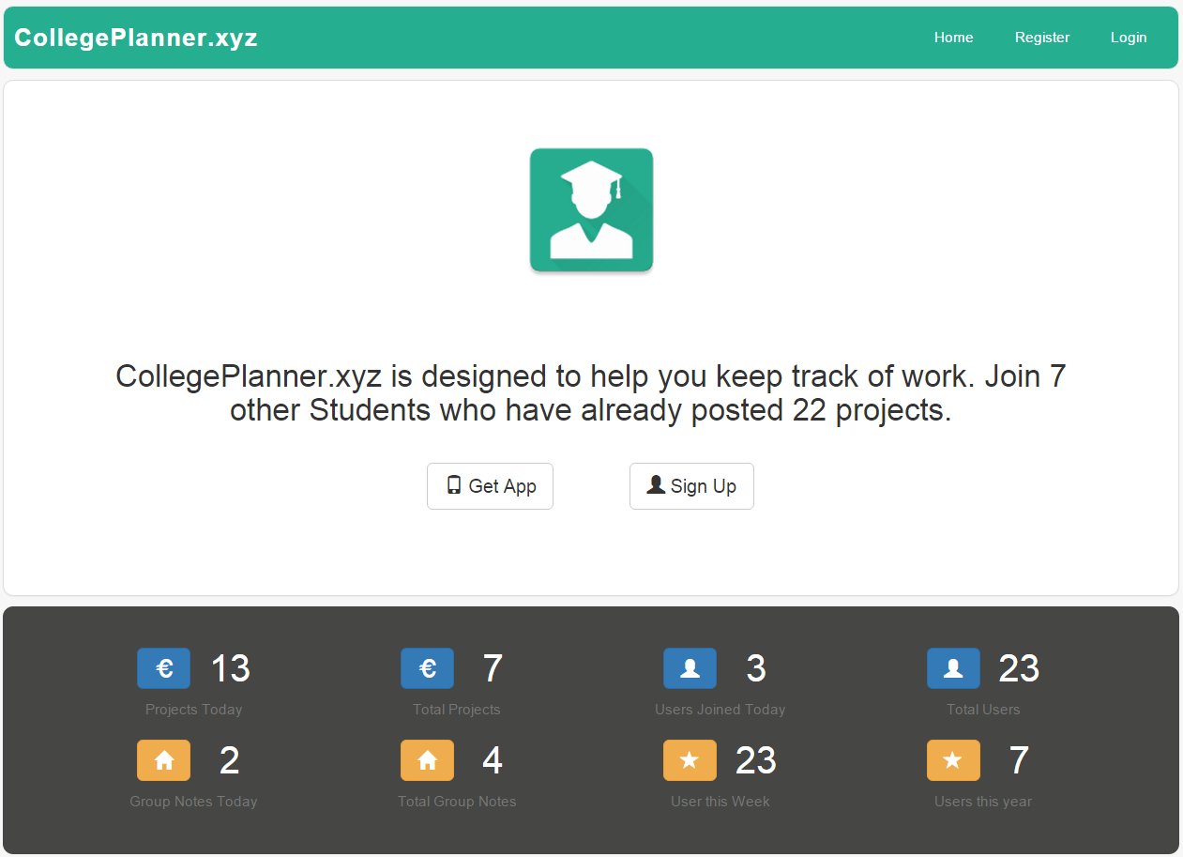
Screenshot
Home Screen – Logged Out
This is what the user is first presented with when visiting the site. They are asked to either signup/login or download the Android App. Dynamic site Statistics are displayed in the body and footer.

Slide 8
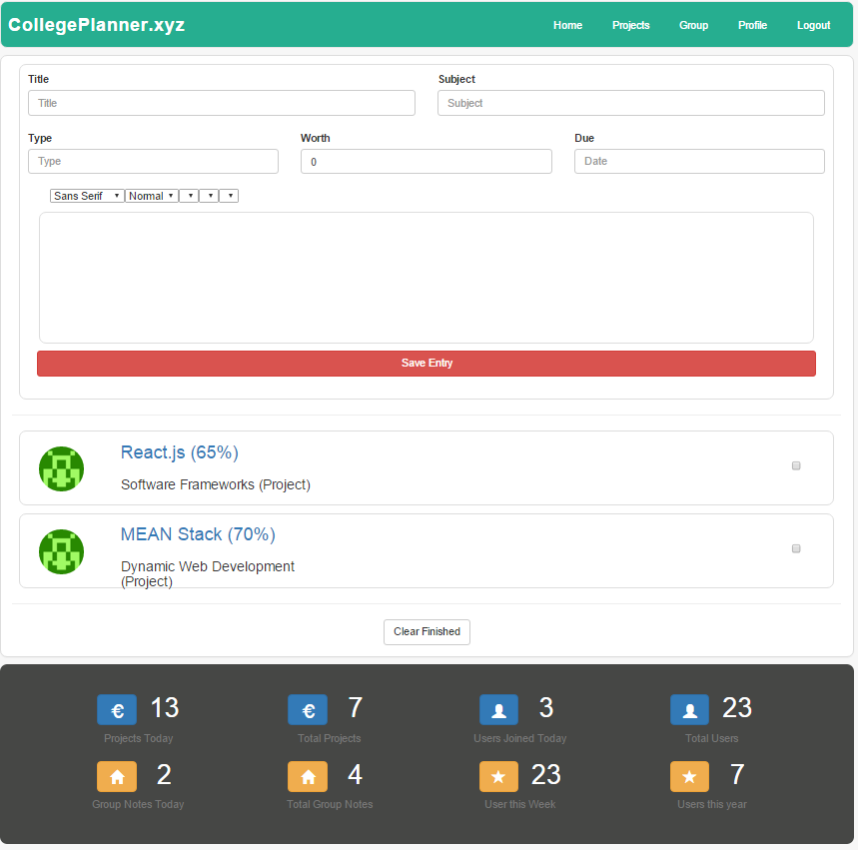
Screenshot
Home Screen – Project View
This is a list of User Projects with the Project. The User can click on individual Projects which will bring up the Form and fill it with the project details to update.

Slide 9
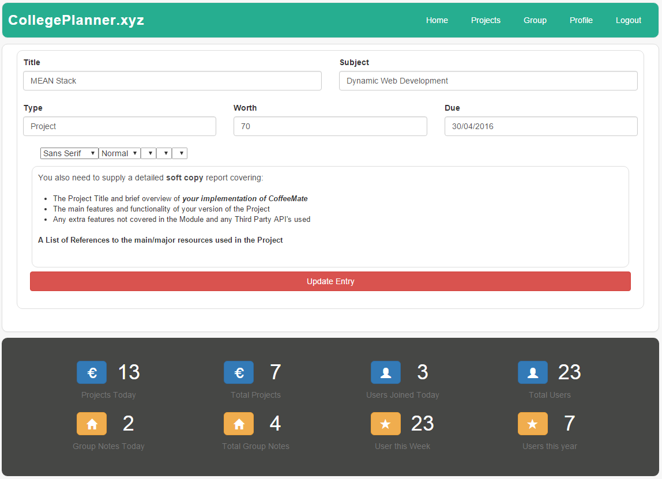
Screenshot
Home Screen – Project Update View
When a user clicks a project from the list the details are sent as parameters to the form so the user can add or modify notes. The Save Button also becomes an Update button.

Slide 10
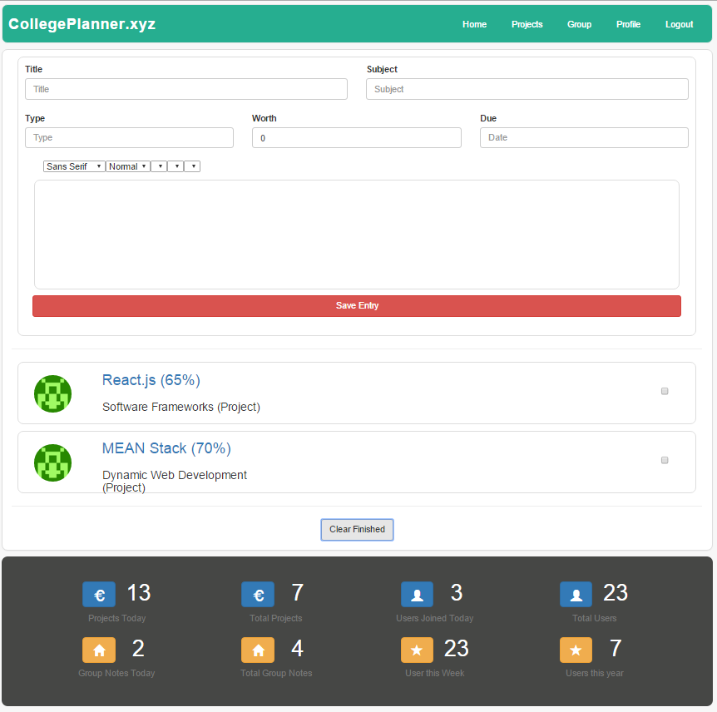
Screenshot
Group Notes Screen – 2 Notes Added
This is the Group Notes Screen showing only the Group notes for Waterford IT, Software Systems Development. It only shows notes for the Users College Group.

Slide 11
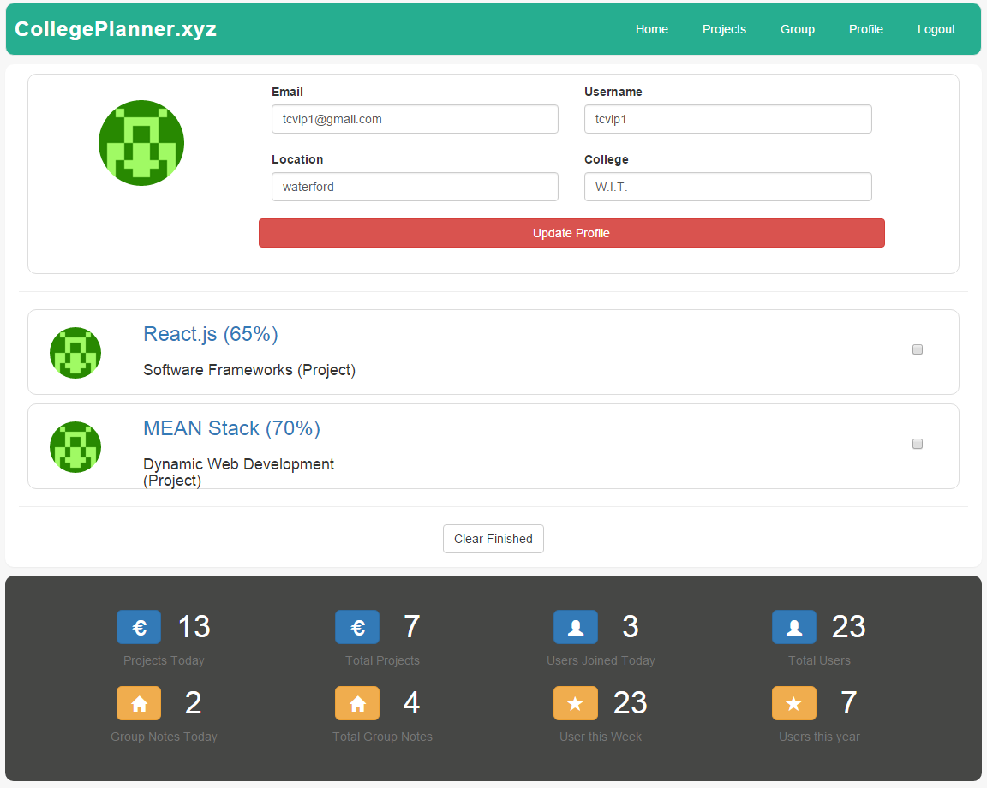
Screenshot
User Profile Screen
This is the Screen which is shown when someone clicks on a users name. It will show all projects posted by the user. The user can also Modify their profile if desired.

Slide 12
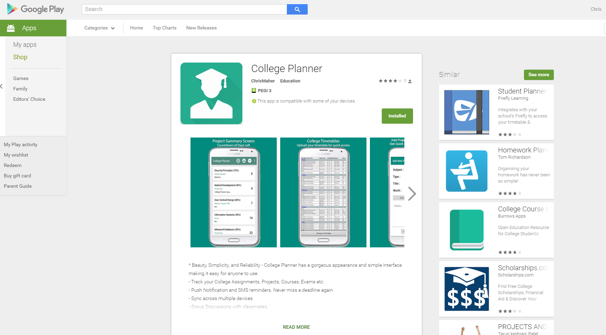
Screenshot
Play Store - Android App
This is the store listing for the Android app for the College Planner Website

